Slide 1
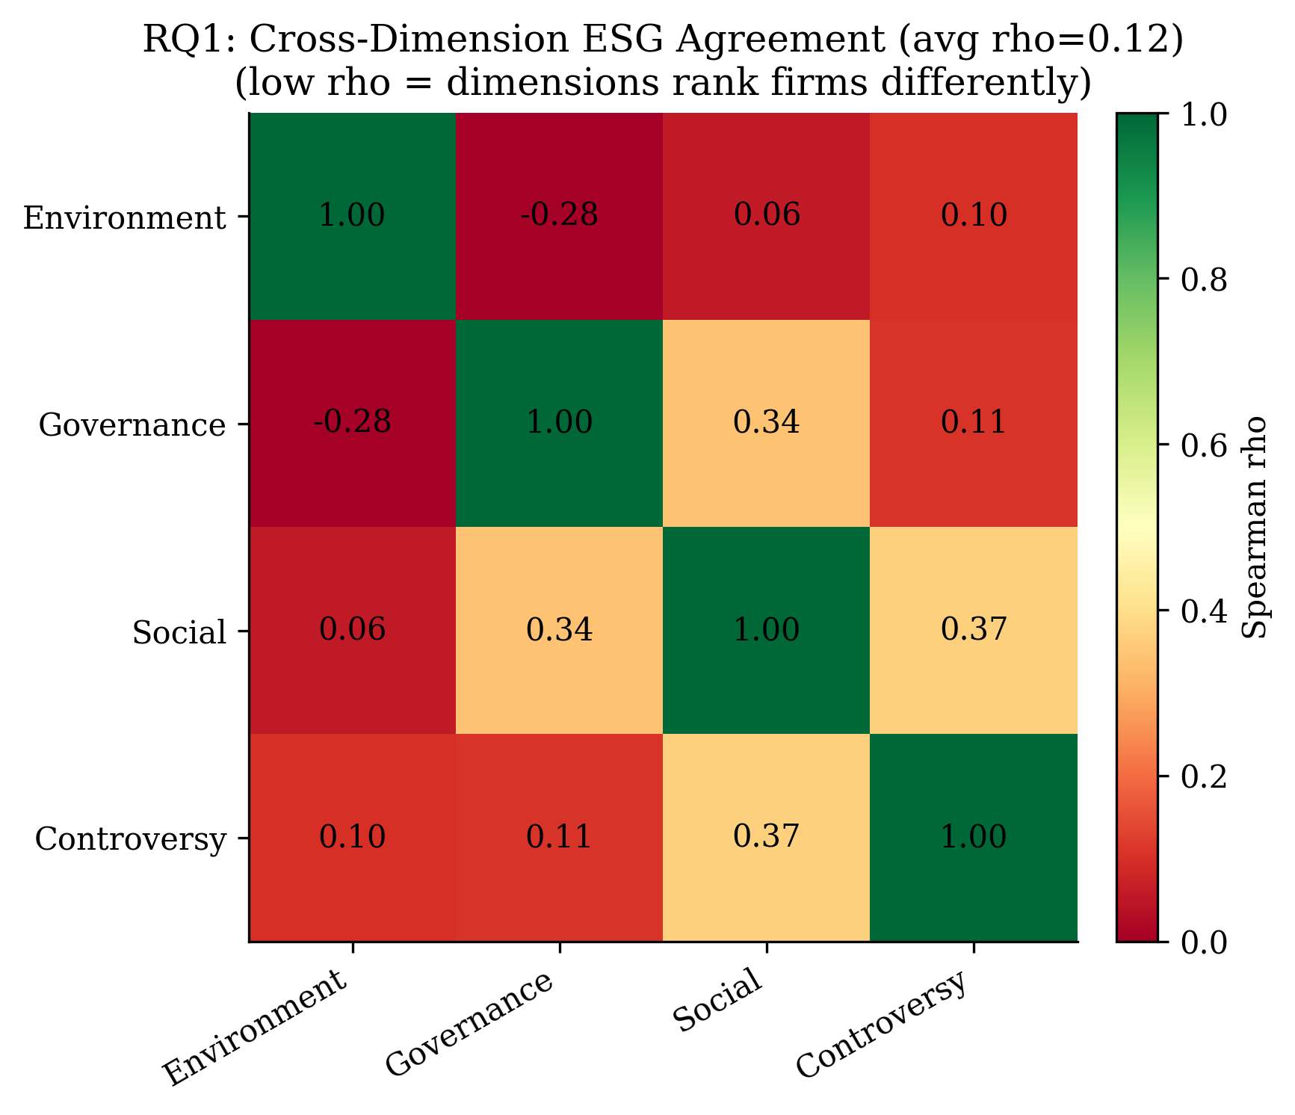
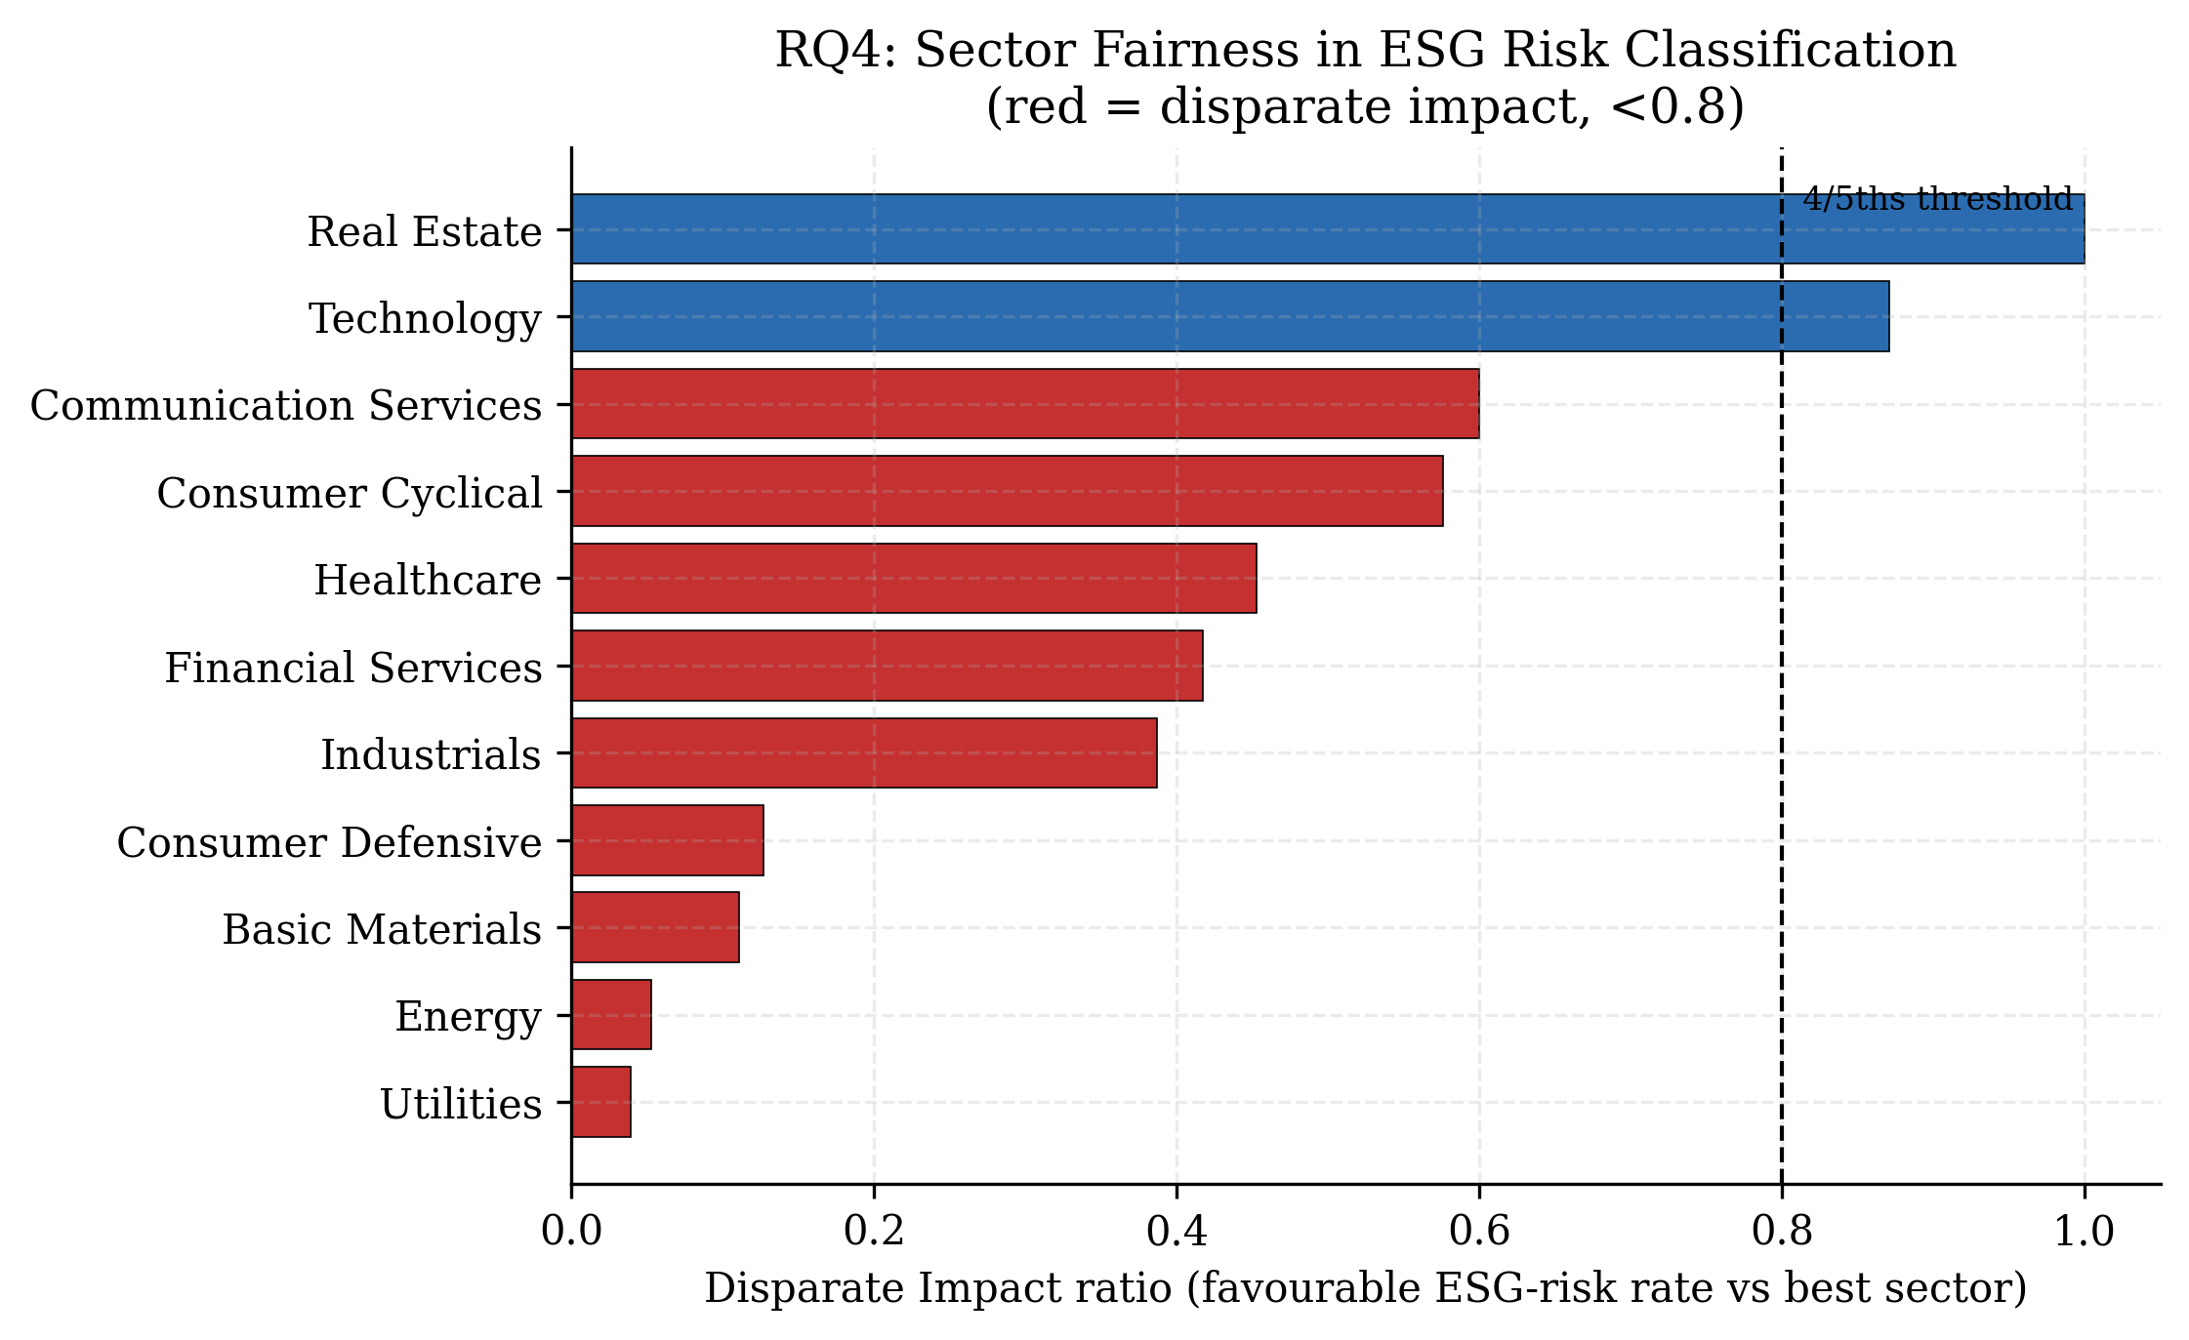
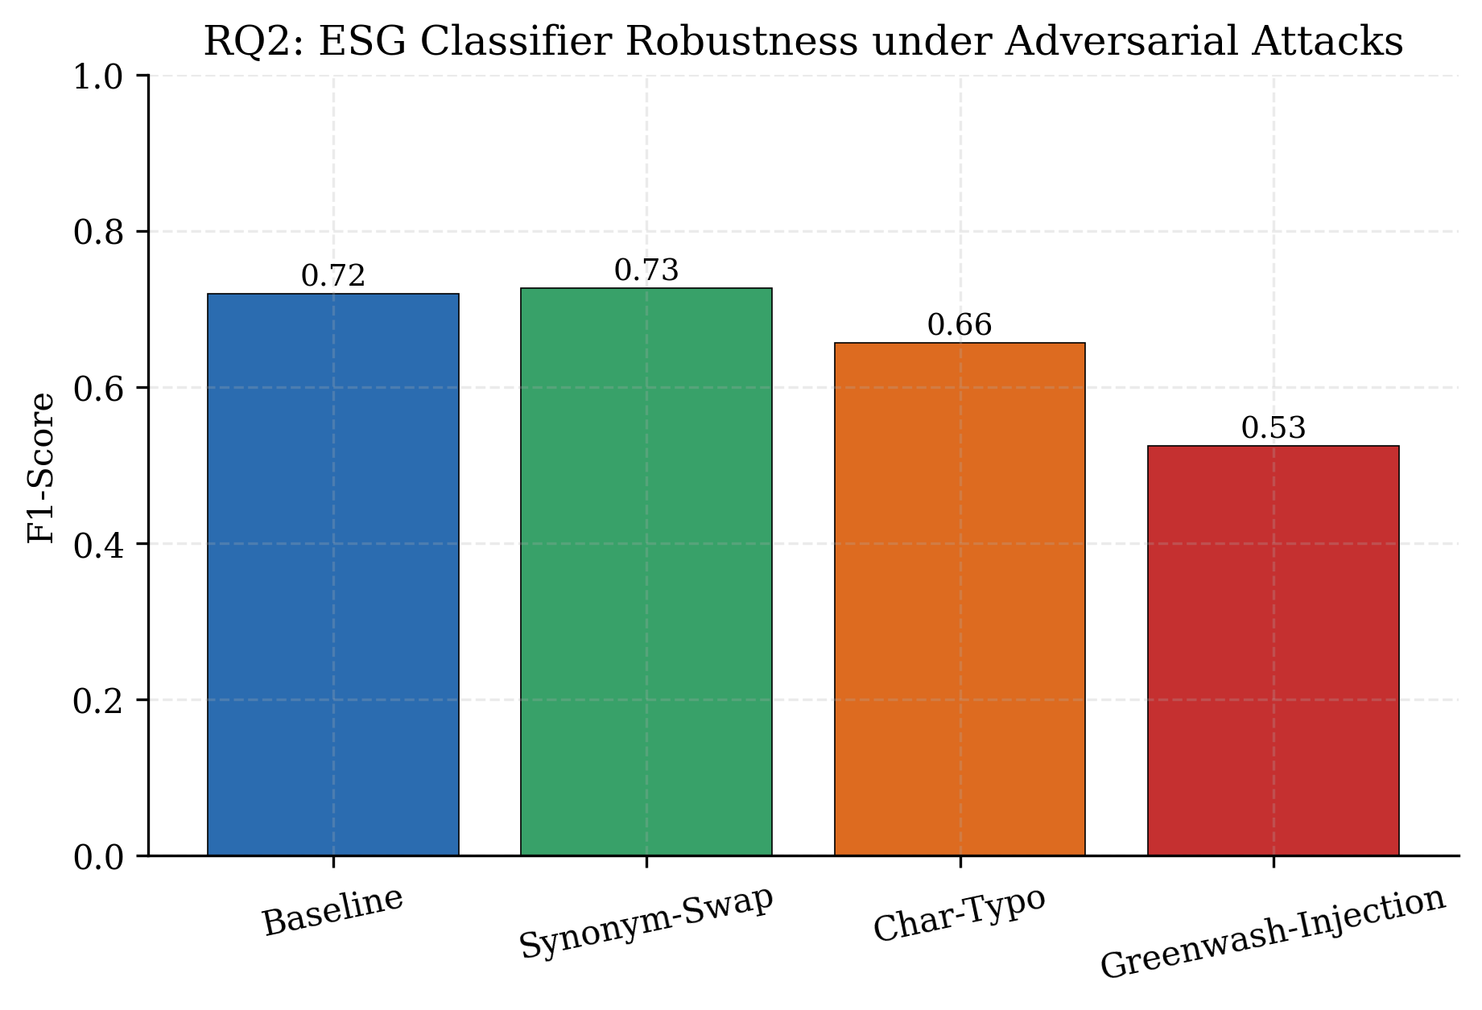
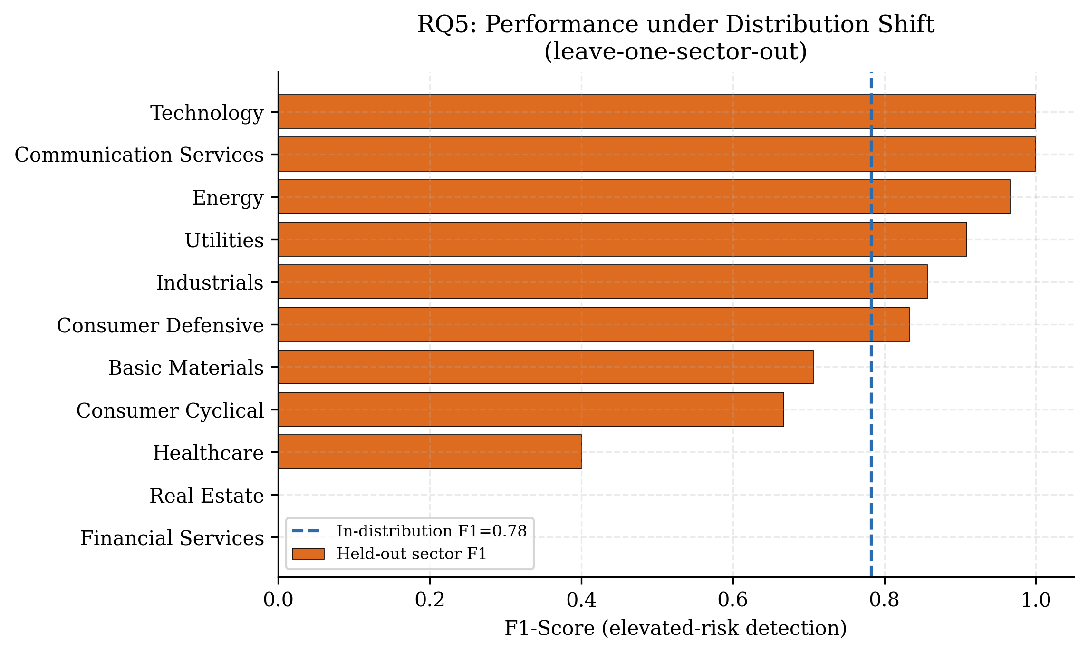
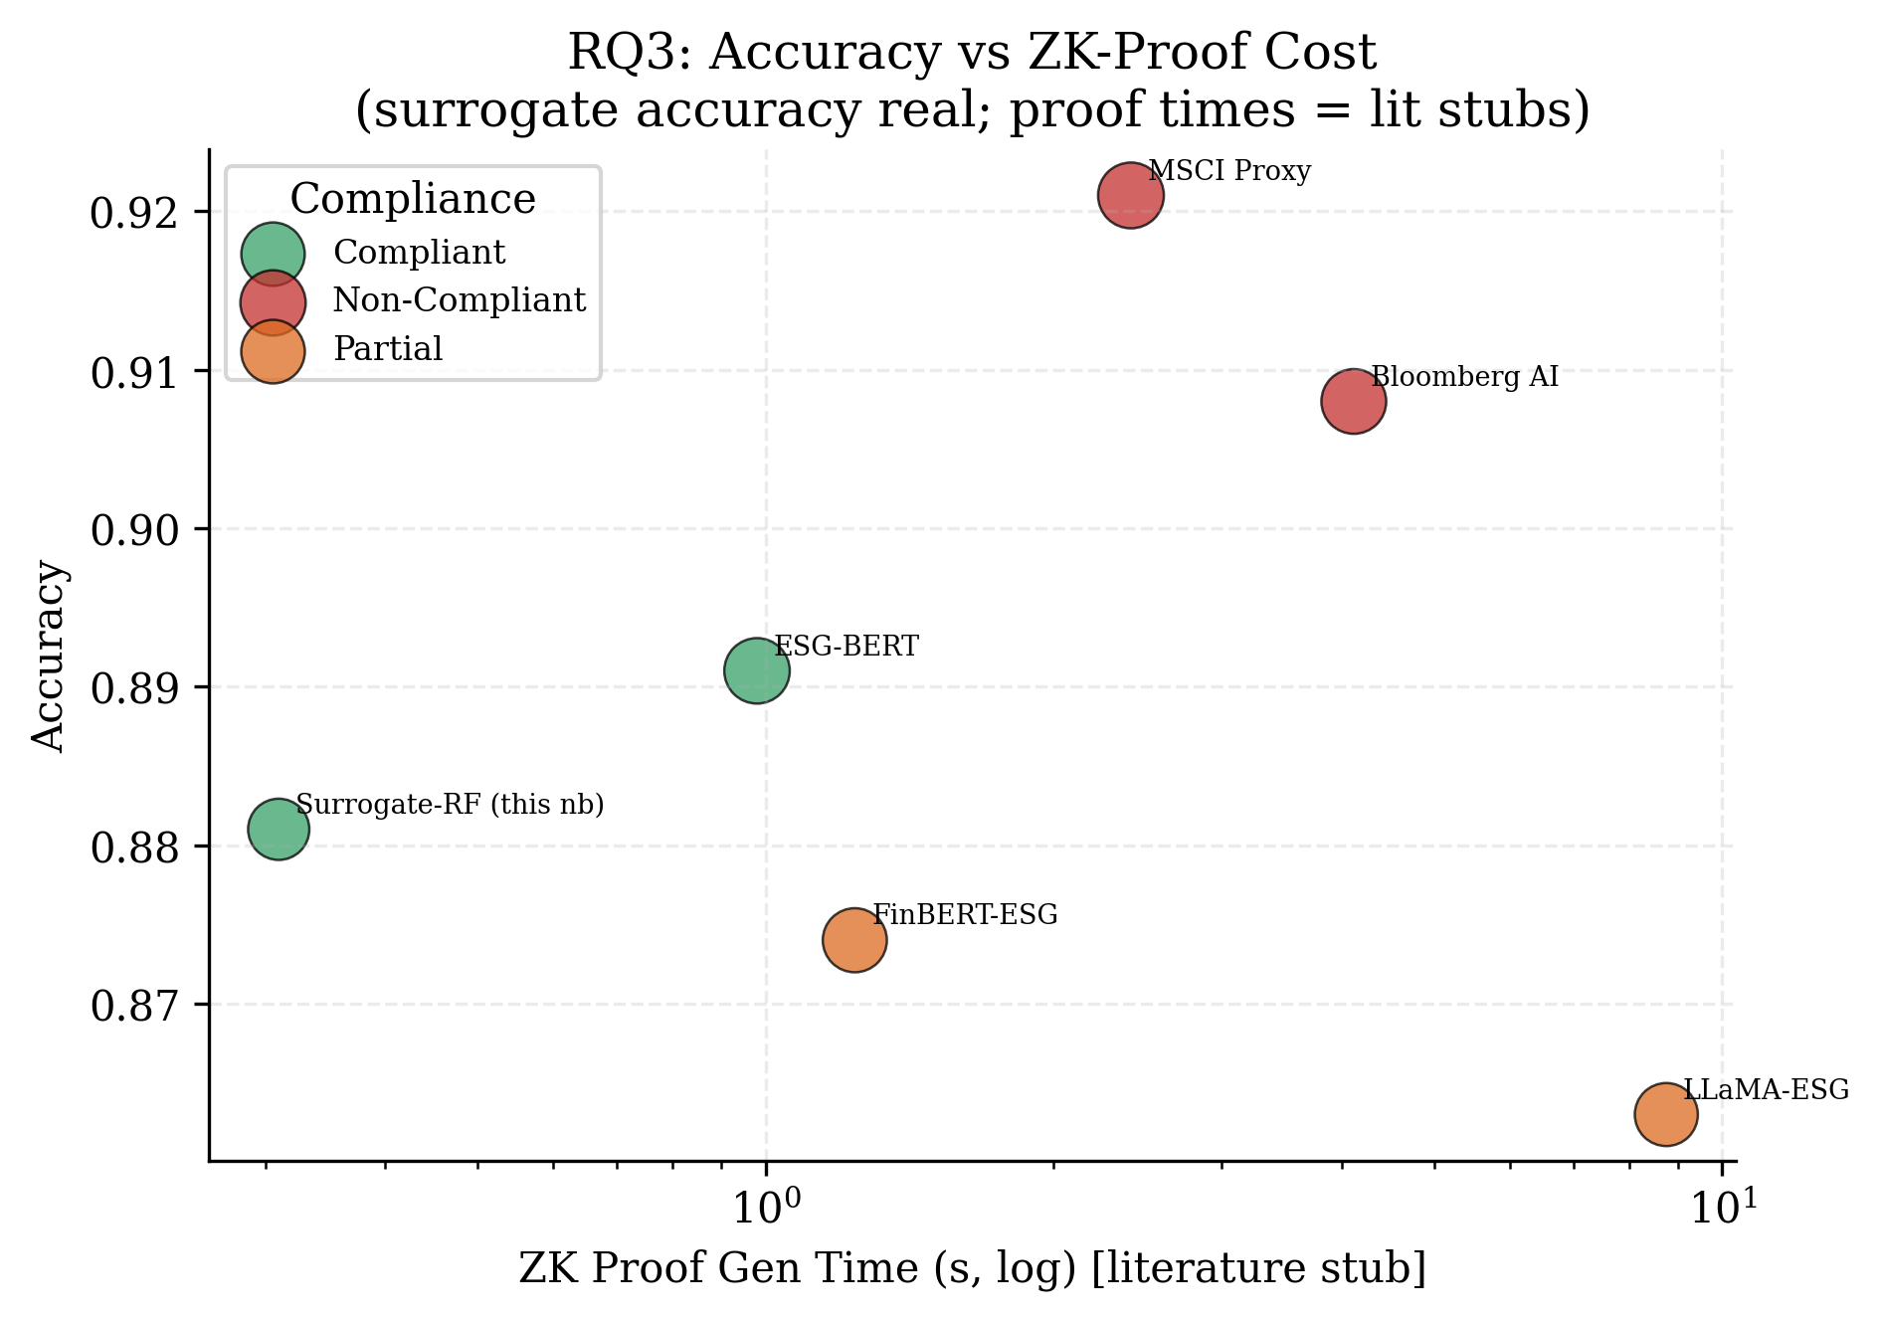
Auditing AI-Based ESG Scores
How much can you trust a machine-generated sustainability score?
AI, Power & Responsibility — Governing Intelligent Systems for Sustainability
Deepak · M.Sc. AI & Sustainability · Business, University of Europe Applied Science · deepakkatukuri@gmail.com
METHODOLOGY WORKFLOW
1
2
3
4
5
Data
Collection
Pre-
processing
Model
Training
Evaluation &
Audit (RQ1–RQ5)
Insights &
Recommend.
1
Why this matters
4
Results — RQ1 to RQ3
5
Results — RQ4 & RQ5
AI systems now assign the ESG scores that move money — pension funds, index weightings and lending all lean on them. The trouble is what sits underneath. Providers rank the same firm very differently, the text models can be talked out of a verdict by the right buzzwords, and almost none of it is open to inspection.
We put AI-based ESG scoring through five separate stress tests, on two public datasets, with code anyone can re-run.
RQ1 · Sub-scores barely agree
RQ4 · Sector bias real, size bias not
2
The data
Public Company ESG Ratings
503 S&P 500 firms · environment, social, governance and controversy risk scores, sector, headcount, risk level.
Across 430 firms the four risk dimensions rank companies almost independently — average Spearman ρ of just 0.12. A single headline ESG number hides real internal disagreement.
Energy and Utilities firms almost never reach the low-risk band (disparate-impact ratio near 0.05 — well below the 0.8 line). Split by headcount and there is no disparate impact: small, mid and large firms fare about the same. The unfairness is sectoral, not about size.
S&P 500 ESG Report Sentences
~2,600 labelled sentences from sustainability reports (text + binary label). Used for the text-robustness test.
RQ2 · Greenwashing breaks it
RQ5 · Holds up, until it doesn't
3
Five questions
RQ1
Do a rater's own ESG sub-scores even agree on which firm is better?
RQ2
Can adversarial or greenwashing text fool an ESG classifier?
RQ3
Can a closed model be audited without handing over its weights?
The model shrugs off synonym swaps and typos (F1 stays near 0.72). Pad the same sentences with green buzzwords and F1 falls to 0.53 — a 27% drop. The cheapest attack does the most damage.
Trained on every sector but one, the model usually transfers fine. Hold out Financial Services or Real Estate, though, and elevated-risk detection collapses to zero F1. Stable on average, broken on a whole slice of the market.
RQ4
Do the scores quietly penalise some sectors or firm sizes?
RQ3 · Closed models still auditable
7
Takeaway
RQ5
Does a model still work when the kind of firm it sees changes?
What's new here
AI-based ESG scores are useful but fragile. Within one rater the dimensions disagree, the text models can be gamed by greenwashing, whole sectors get penalised, and performance can vanish on firms the model hasn't seen enough of.
Before scores like these steer real capital, they need the same routine auditing we expect of any high-stakes model.
6
✓ Divergence measured inside one rater, not just between raters
✓ A greenwashing-specific robustness test for ESG text models
A surrogate reproduces the vendor's risk levels at 88% accuracy from scores alone — enough to check a closed model behind a zero-knowledge proof. Proof times are from the ZK literature, not measured here.
✓ A surrogate-model route to auditing closed vendor scores
Keywords: ESG · explainability · robustness · fairness · greenwashing · AI governance
✓ Sector and firm-size fairness checks using the 4/5ths rule
✓ A distribution-shift test standing in for temporal drift

